Slide 1

BC2410, Prescriptive Analytics From Data to Decisions
Lecture 10

Slide 2
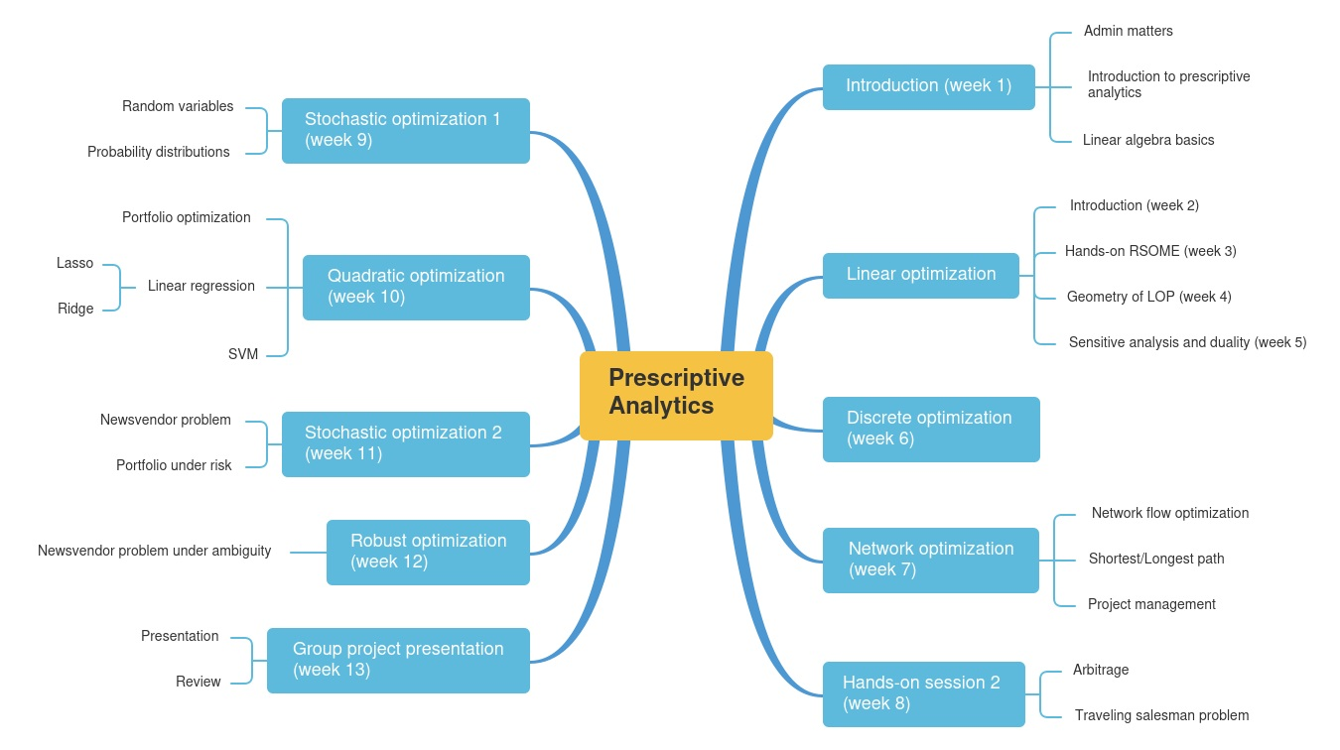
Schedule

Slide 3
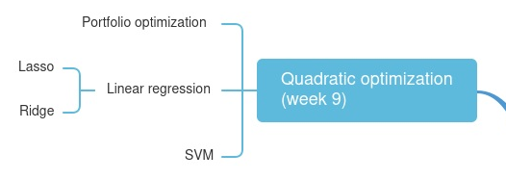
Schedule

Slide 4

Do you know how to build a portfolio based on historical stock data?

Slide 5
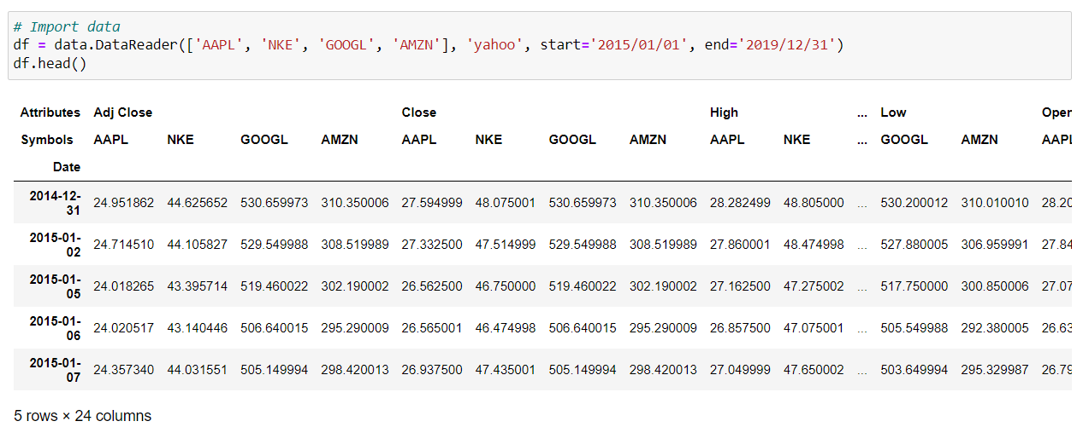
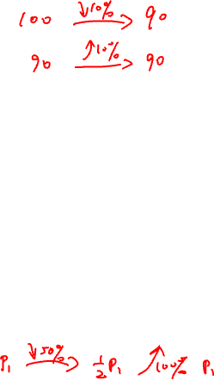
Real Data---Historical Data
*
#
*The adjusted closing price amends a stock's closing price to reflect that stock's value after accounting for any corporate actions.
#The closing price is the raw price, which is just the cash value of the last transacted price before the market closes.
Notes:
The adjusted closing price amends a stock's closing price to reflect that stock's value after accounting for any corporate actions.
The closing price is the raw price, which is just the cash value of the last transacted price before the market closes.

Slide 6
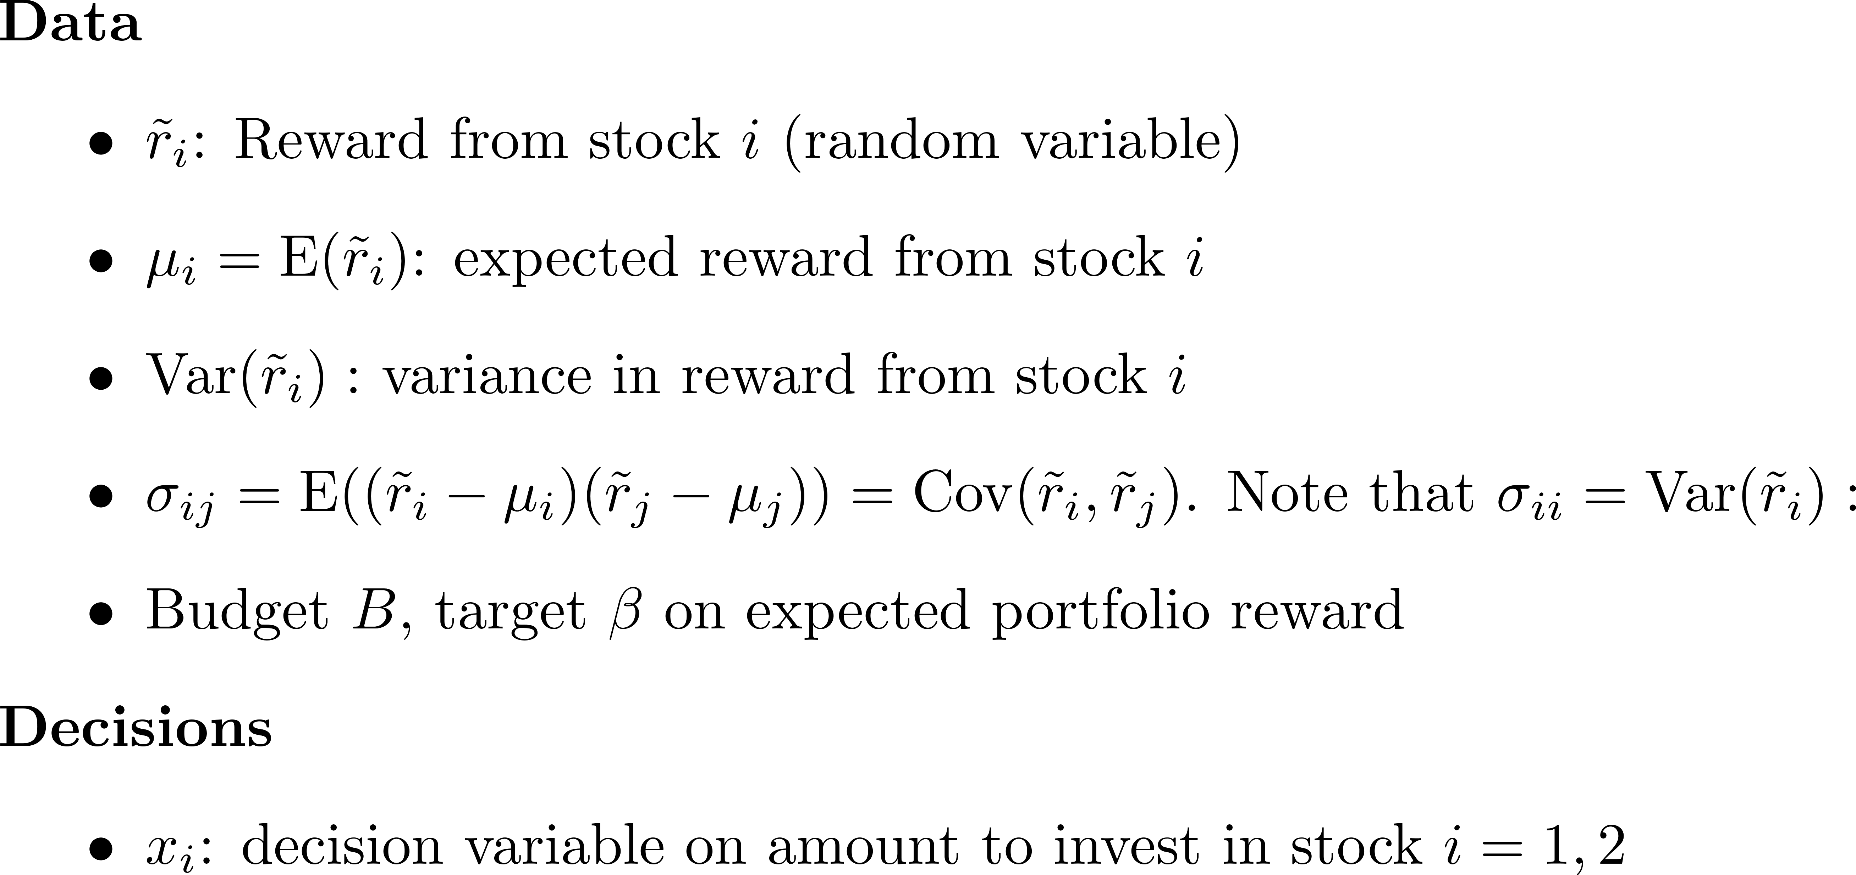
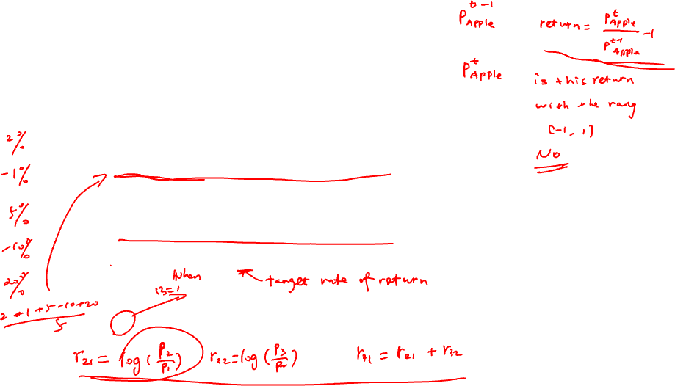
Classical Portfolio Selection

Slide 7
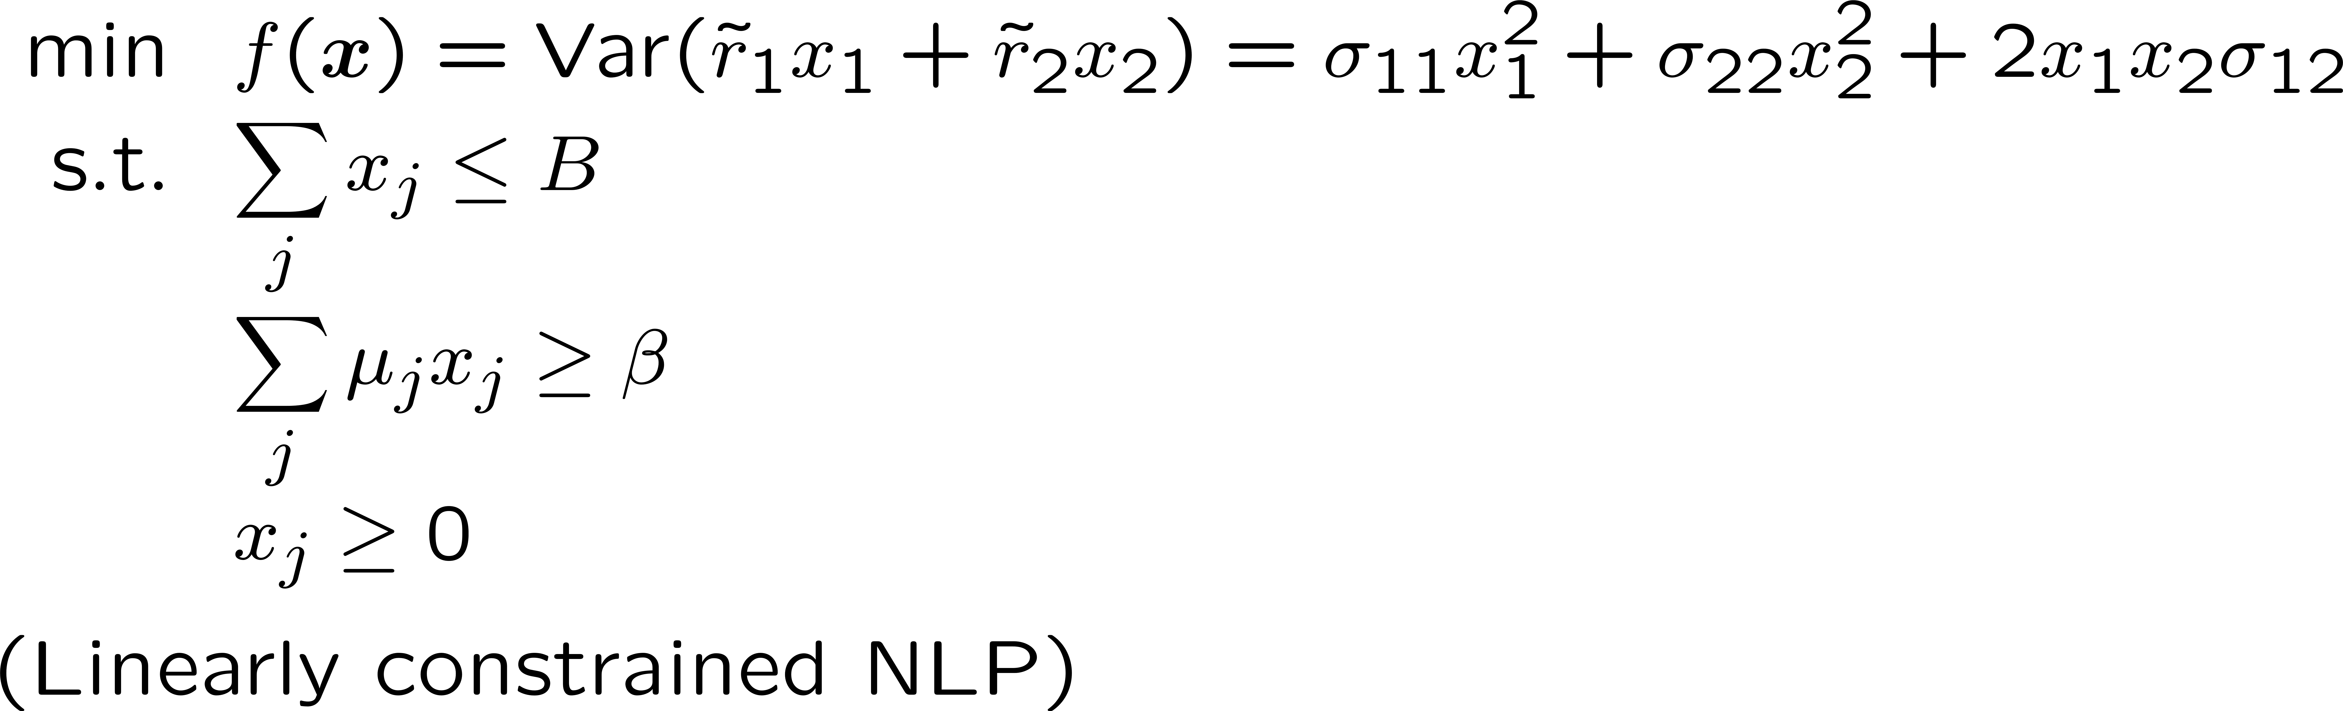
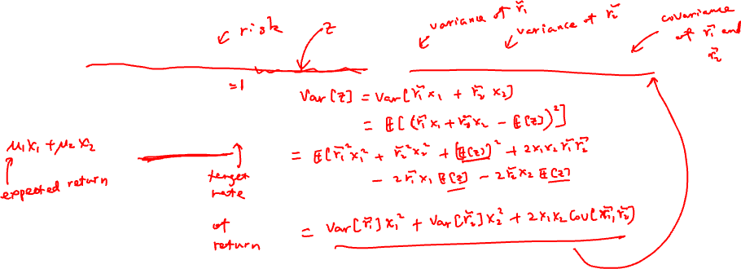
Markowitz Portfolio Optimization
Objective: Minimize total portfolio variance so that
Expected reward of total portfolio is above target β
Total amount invested stay within our budget
No short sales

Slide 8
Generalization of Portfolio Variance

Slide 9
Generalization of Portfolio Variance

Slide 10
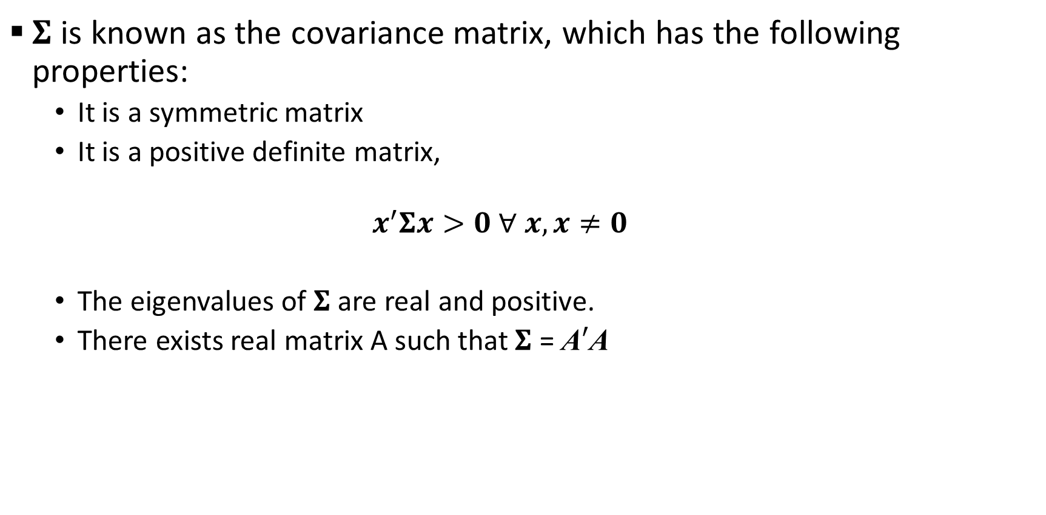
Generalization of Portfolio Variance (Optional)
$Σ$ is known as the covariance matrix, which has the following properties:
It is a symmetric matrix
It is a positive definite matrix,
$$x^{′}Σx>0 ∀ x, x≠0$$
The eigenvalues of $Σ$ are real and positive.
There exists real matrix A such that $Σ$ = A$′$A

Slide 11
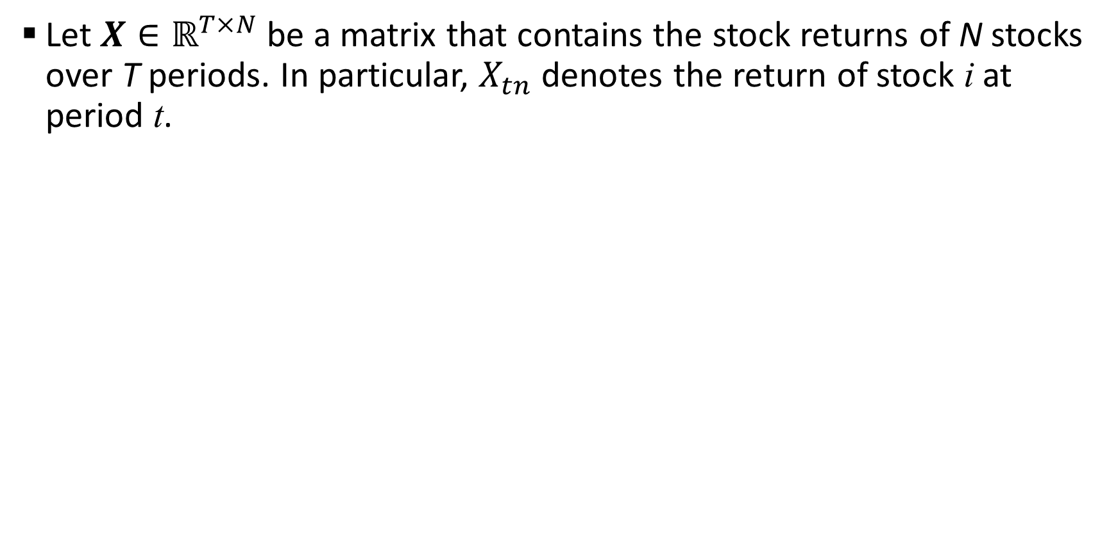
Covariance Matrix from Data
Let $X∈ℝ^{T×N}$ be a matrix that contains the stock returns of N stocks over T periods. In particular, $X_{tn}$ denotes the return of stock i at period t.

Slide 12
Covariance Matrix from Data

Slide 13
Compact form of Portfolio Selection Problem

Slide 14
Quadratic Optimization Problems (Optional)
Notes:
Max mu’x
St. x’Sigma x <= p
X >= 0
Can be solved.
But
Max mu’x
St. x’Sigma x >= p
X >= 0
Cannot be solved. Not QOP.
This related to convex of the function.
Max x’Sigma x is much much harder problem.

Slide 15
Another Portfolio Selection Problem (Optional)
Objective: Maximize probability that portfolio returns exceeds target β
Expected reward of portfolio above β
Total investment stays within budget B
No short sales
Assume returns are normally distributed

Slide 16
Another Portfolio Selection Problem (Optional)

Slide 17
Sharpe Ratio (Optional)

Slide 18
Another Portfolio Selection Problem (Optional)

Slide 19
Another Portfolio Selection Problem (Optional)

Slide 20
Another Portfolio Selection Problem (Optional)

Slide 21
Another Portfolio Selection Problem (Optional)

Slide 22
Another Portfolio Selection Problem (Optional)

